Slide 1


Lecture 2: Data Science pt. I
COMP704: Machine Learning
MSc Artificial Intelligence for Games

Slide 2
Today’s session:
Dig into Data Science & Machine Learning
Look at data acquisition
Prepare for this week’s workshop

Slide 3
Dig into Data Science & Machine Learning

Slide 4
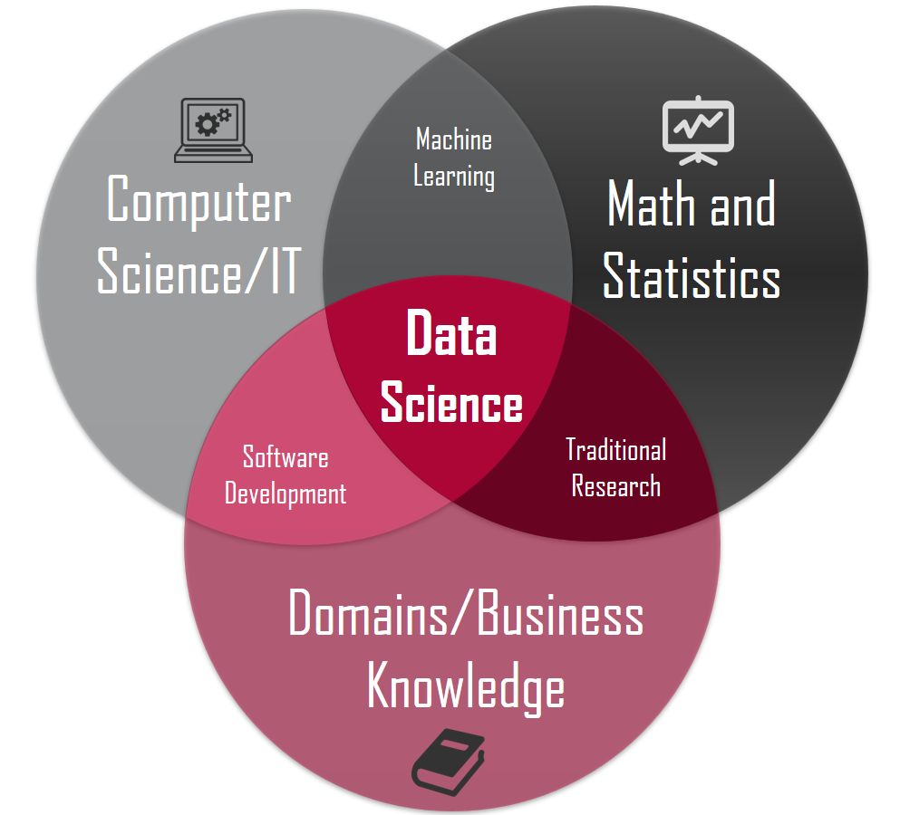
Dig into Data Science & Machine Learning
Last week, we looked at DS & ML
Data Science is the overall activity
Machine Learning is the fun part ;)

Slide 5
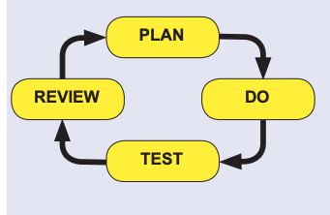
Dig into Data Science & Machine Learning
Data Science as a process
Science is the key part of data science

Slide 6
Dig into Data Science & Machine Learning
Machine Learning as a process
Learning is the key part of Machine Learning
What does Searle tell us about learning in the Chinese Room?
Learning is ‘getting better’
Learning is not meaning
Learning is not knowledge
Often, a strong relationship between knowledge and introspection & reflective practice
As much as I said domain experts will often use tactic or heuristic knowledge in their fields, they can normally go back to first principles to explain their processes (it may be painful)
Be mindful of domain specificity when talking about learning & knowledge ;)

Slide 7

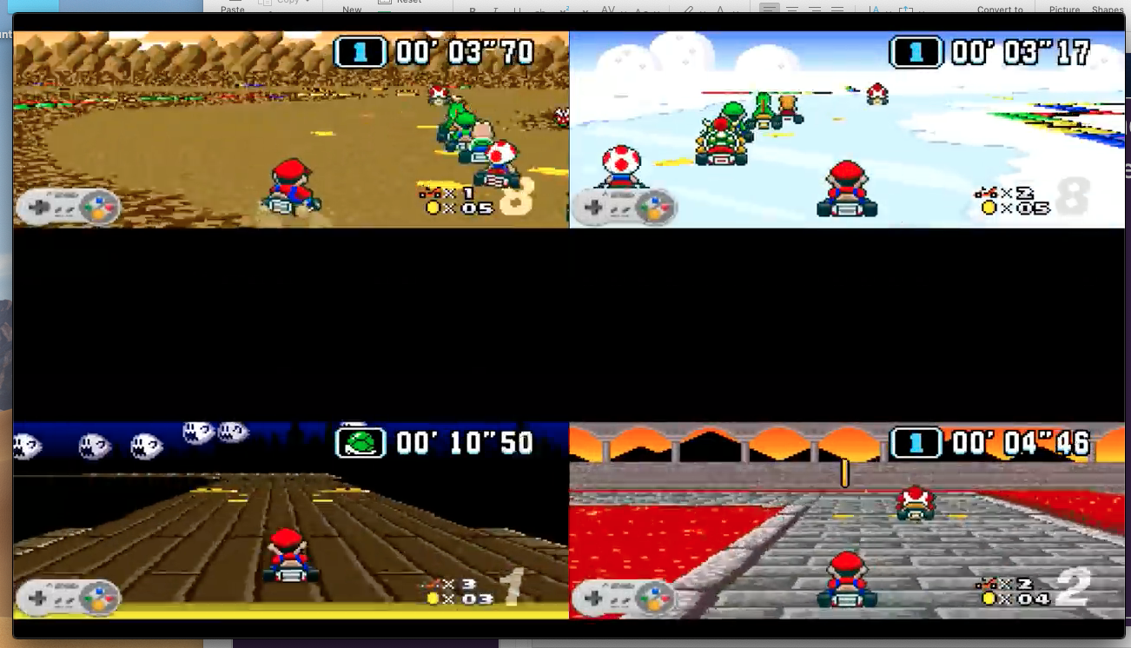
Dig into Data Science & Machine Learning
Machine Learning in practice
MariFlow - Self-Driving Mario Kart w-Recurrent Neural Network

Slide 8


Dig into Data Science & Machine Learning
Types of Machine Learning
Given that ML is the intersection of compsci and stats, we need to think of learning as error reduction
Already said that ML is not knowledge-based so ‘self-awareness’ is unlikely to happen
https://www.vox.com/future-perfect/2018/11/2/18053418/elon-musk-artificial-intelligence-google-deepmind-openai

Slide 9
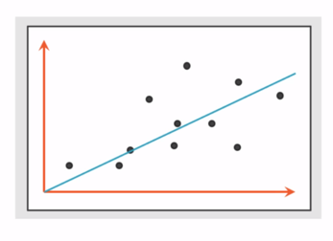
Dig into Data Science & Machine Learning
Types of Machine Learning
Regression
work out a continuous relationship between inputs and outputs
Like standard regression, but for multiple dimensions
E.g.:
Based on other examples, what is the value of something (house, car, watches, staff etc)
How much is a player likely to spend on my game through IAPs
When should I replace server equipment
Typically, complex data is not ‘linear’, regression is generally split into buckets (short segments of linearity)

Slide 10
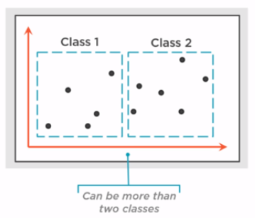
Dig into Data Science & Machine Learning
Types of Machine Learning
Classification
Group inputs in to a single classification
Data sorting
E.g.
Mario example (classifications are which buttons should be pressed)
Is player behaviour normal?
Is a credit card transaction fraudulent?
This is typically ‘classical machine learning’
Uses neural networks (back prop)
Or Marflow-style networks

Slide 11
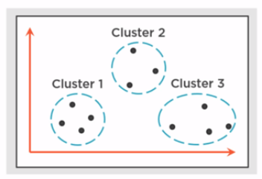
Dig into Data Science & Machine Learning
Types of Machine Learning
Clustering
Group related inputs in to distinct clusters / groups
(More) Data sorting
But the algorithms look to determine clusters without being told what they should be
Ideal for emergent clusters
Cooccurrence
Causality
E.g.
What play styles do our players have (Bartle’s Player Types)

Slide 12
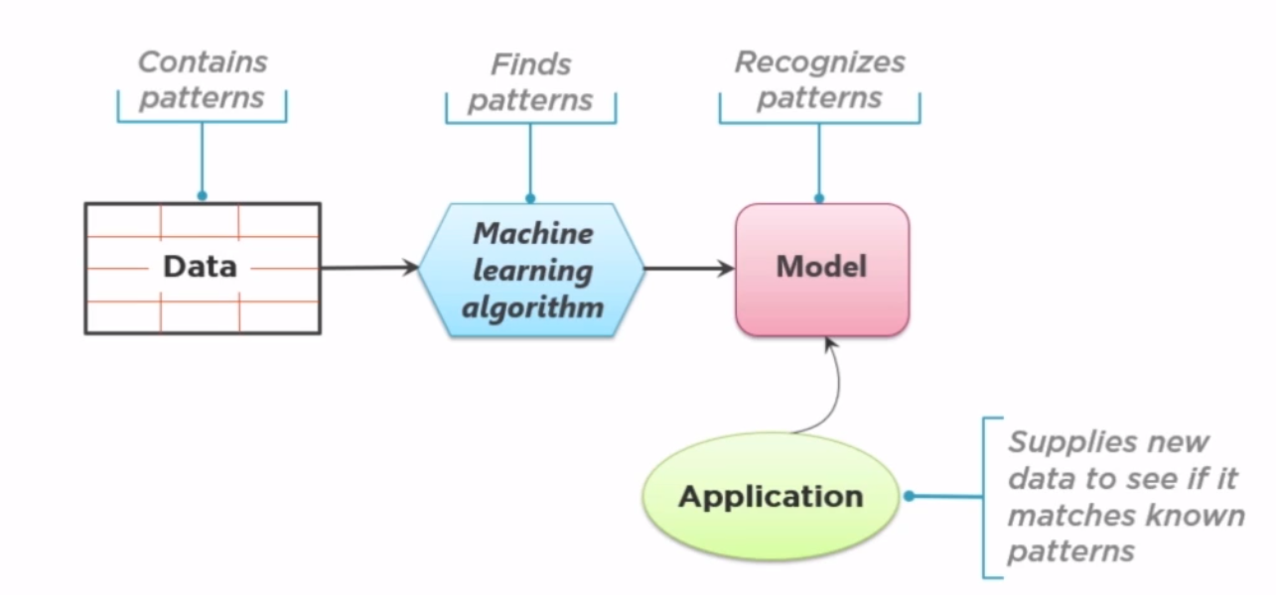
Dig into Data Science & Machine Learning
Process of Machine Learning

Slide 13
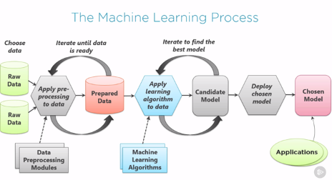
Dig into Data Science & Machine Learning
Process of Machine Learning

Slide 14
Dig into Data Science & Machine Learning
Process of Machine Learning
Data Collection & Processing
Training & Learning
Deploying & Using
Note all the scope for iterating

Slide 15
Dig into Data Science & Machine Learning
Process of Machine Learning
Data collection & processing
Collect enough suitable data for training & testing
Typically, this will be ‘live’ data that can come from a multitude of sources
Scope to use historic data too
Need to process the data into forms that make sense for training
This will all depend on type of ML used and algorithms used within that type

Slide 16
Dig into Data Science & Machine Learning
Process of Machine Learning
Training & learning
ML describes two broad learning paradigms
Supervised
Training is done with data + expected outcome (like classroom training)
Learning algorithm will look to minimise error between expected outcome and current outcome
Typically
Regression & classification
Unsupervised
Training is done with data but no expected outcomes as algorithm will self-organise representations
Typically
Clustering

Slide 17
Dig into Data Science & Machine Learning
Process of Machine Learning
Training & learning
Typically, data is split into two sets:
Training data
In supervised learning
Algorithm is trained with training data to achieve desired / best (minimum) errors
In unsupervised learning
Algorithm is just presented with training data
Test data
Novel test data is presented to the algorithm to assess performance with new cases
Performance can be assess quantitatively with a confusion matrix

Slide 18
Dig into Data Science & Machine Learning
Process of Machine Learning
Iterating data collection & processing and Training & learning phases
Typically, testing an ML solution will result in issues
Over-fitting
training has been so heavily geared to training data, solution doesn’t perform well with novel data
Learning the data and not the trends
Under-fitting
both training data and novel data produce poor results
Algorithm may not be a good fit for data
May not have enough data to train with

Slide 19
Dig into Data Science & Machine Learning
Process of Machine Learning
Iterating data collection & processing and Training & learning phases
May require iteration in training and learning
Change algorithm parameters
Change algorithm
May require iteration in data collection & processing
Process existing data differently
Collect different data

Slide 20
Dig into Data Science & Machine Learning
Process of Machine Learning
Deploying and using
Once an algorithm has trained the data to acceptable performance (accuracy) it can be packaged and put into use
Take algorithm data and package into application
In games and most applications, as a black box AI component

Slide 21
Dig into Data Science & Machine Learning
Machine Learning in Python
Python has a lot of support for industrial and academic ML
Lots of package support
The pipeline we will use
Other pipelines & parts are available
TensorFlow
ML.net
etc
Raw data
numpy
pandas
scikit-learn

Slide 22
Dig into Data Science & Machine Learning
Machine Learning in Python
Numpy
A library for ‘array & linear algebra’ for ‘large datasets’
Pandas
PANel DAta
Process data ‘like excel in code’
Scikit-learn
Library of ML algorithms

Slide 23
Look at data acquisition

Slide 24
Look at data acquisition
Two broad approaches to data acquisition
Live data (take from running services)
Historical data (take from offline sources)
Both require data processing (dependent on the data & solution requirements)

Slide 25
Look at data acquisition
Live Data (analytics / metrics)
This is a common activity for GaaS and is a core part of their business
Regression
Customer spend
Classification & clustering
Customer behaviours
Relatively easy for GaaS, not so for traditional games

Slide 26
Look at data acquisition
Live Data (analytics / metrics)
Game As a Service (thin client)
Typically, a thin client GaaS will have all the ‘important processing done on the server and just take user input and drawing on the client
Easy to collect server-side data & instrument & re-instrument server code to collect different data
Server
Client
Model
View
Controller

Slide 27
Look at data acquisition
Live Data (analytics / metrics)
Standalone Game with analytics support
Typically, standalone game will be a black box
Only updated through patching
(Potentially) costly to send data to analytics server
Need to think about data packaging
Game
Analytics Service
Model
Model
Controller
Controller
View

Slide 28
Look at data acquisition
Approaches:
Save data to a local text file and process
Save data as csv, xls, xml, json etc
Send data to a server using HTTP (or other protocols)
Manage data as flat files
Manage data through xls, sql
Remember, ML has a tendency to create large amounts of data, so it needs to be stored carefully.

Slide 29
Look at data acquisition
What to save?
All the keystrokes / game events
Can generate lots of data that may not process well
Do sessional processing locally & send results
Treat each play-through of game as a ‘session’ and send key results
Can work but relies on you having the correct data
Label game events and send
Again, relies on you having the correct data

Slide 30
Look at data acquisition
We can see that ML & DS move the burden away from writing algorithms to working with data
What to capture
How to capture it
How to process it
Then worry about training

Slide 31
Prepare for this week’s workshop

Slide 32
Prepare for this week’s workshop
For this weeks’ workshop, we will look at different ways of collecting data from a game
Flat files
Json
Openpyxl
HTTP
And how we can store data from multiple players & sessions
Excel
Sql

Slide 33
Do you have any questions for me

